Slide 1
From Algorithm to the Clinic: Designing a Usable Clinical Decision Support (CDS) Interface and EHR Integration Strategy
Team HAC

Slide 2
Roadmap (1/1)
Research Question – Why are we doing this?
Causal Models - How We Compare Models
Clinical Heterogeneity – One treatment does NOT fit all patients?
Conclusions
Model Pipeline - How We Find Answers?
Key method – Why we can trust the pipeline
Data exploratory and Preprocessing- EDA drives design

Slide 3
We would like to thank the authors of the papers referenced in this study.
Asgharnezhad, A., et al. (2025). Enhancing Monte Carlo dropout performance for uncertainty quantification (arXiv preprint arXiv:2505.15671). https://arxiv.org/pdf/2505.15671
Austin, P. C. (2021). Missing data in clinical research: A tutorial on multiple imputation. U.S. National Library of Medicine. https://pmc.ncbi.nlm.nih.gov/articles/PMC8499698/
Djupskås, A., Stasik, A. J., & Riemer-Sørensen, S. (2025). Unreliable uncertainty estimates with Monte Carlo dropout (arXiv preprint arXiv:2512.14851). https://arxiv.org/abs/2512.14851
Lee, K. M., & Emsley, R. (2024). The impact of heterogeneity on the analysis of platform trials with normally distributed outcomes. BMC Medical Research Methodology, 24, Article 163. https://doi.org/10.1186/s12874-024-02293-4
Tamo, J. B. (2026). Causal machine learning for surgical interventions. Big Data Mining and Analytics. https://www.sciopen.com/article/10.26599/BDMA.2025.9020093
Tian, H., Tom, B. D. M., & Burgess, S. (2024). A data-adaptive method for investigating effect heterogeneity with high-dimensional covariates in Mendelian randomization. BMC Medical Research Methodology, 24, Article 34. https://doi.org/10.1186/s12874-024-02153-1
Yang, T., & Noor-E-Alam, M. (2025). Optimizing feature selection in causal inference: A three-stage computational framework for unbiased estimation. arXiv. https://arxiv.org/abs/2502.00501
Maas, C. C. H. M., Kent, D. M., Hughes, M. C., et al. (2023). Performance metrics for models designed to predict treatment effect. BMC Medical Research Methodology, 23, 165. https://doi.org/10.1186/s12874-023-01974-w
Yang, J., Wan, Y., Ni, Q., et al. (2022). Quantifying causal effects from observed data using quasi-intervention. BMC Medical Informatics and Decision Making, 22, 337. https://doi.org/10.1186/s12911-022-02086-z Austin, P. C., White, I. R., Lee, D. S., & van Buuren, S. (2021). Missing data in clinical research: A tutorial on multiple imputation. The Canadian Journal of Cardiology, 37(9), 1322–1331. https://doi.org/10.1016/j.cjca.2020.11.010
Zhao, Z., Zhang, Y., Harinen, T., & Yung, M. (2022). Feature selection methods for uplift modeling and heterogeneous treatment effect. In Proceedings of the 18th IFIP International Conference on Artificial Intelligence Applications and Innovations (AIAI) (pp. 217–230). Springer. https://doi.org/10.1007/978-3-031-08337-2_19

Slide 4
How can patient-specific treatment effects of surgery versus conservative care be estimated to support shared decision making?
For outcome $k∈\left\{1 , … , 5\right\}$:
$${\text{TE}}_{k}\left(x\right)=𝔼\left[Y_{k}\left(1\right)−Y_{k}\left(0\right)∣X=x\right]$$

Slide 5
Model pipeline (1/1)
Data Preparation and Feature Engineering
Explore Data
Propensity Score and Covariate Balance
Propensity Estimation
Causal Meta-Learner Implementations
S-Learner
Feature Selection
Covariate Balance Diagnostics
T-Learner
X-Learner
R-Learner
MLP within a T-learner framework.
Model Selection and Evaluation
5-fold cross-validation
Inverse Transformation TE5
Clinical Heterogeneity and Final Outputs
Driver Analysis
CDS-Ready Table
R-loss, MAE, RMSE
BMI Computation
Missing handling
Data Pre-processing

Slide 6
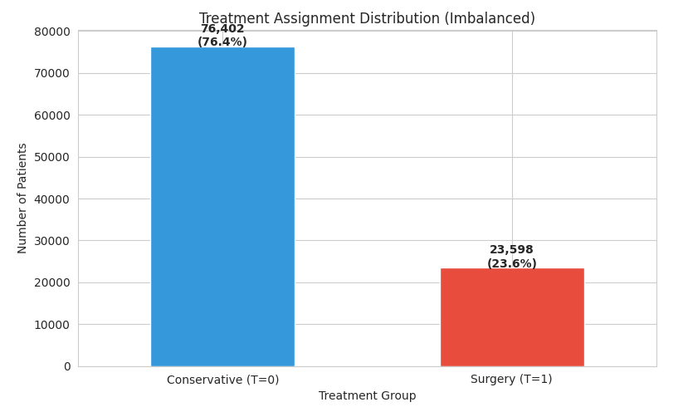
Data exploratory and Preprocessing (1/4)
EDA Insight: Treatment assignment is highly imbalanced (24% surgery).
Implication: Strong selection bias; naive outcome comparisons are invalid.
Solution: Propensity score modeling with IPW and balance diagnostics.

Slide 7
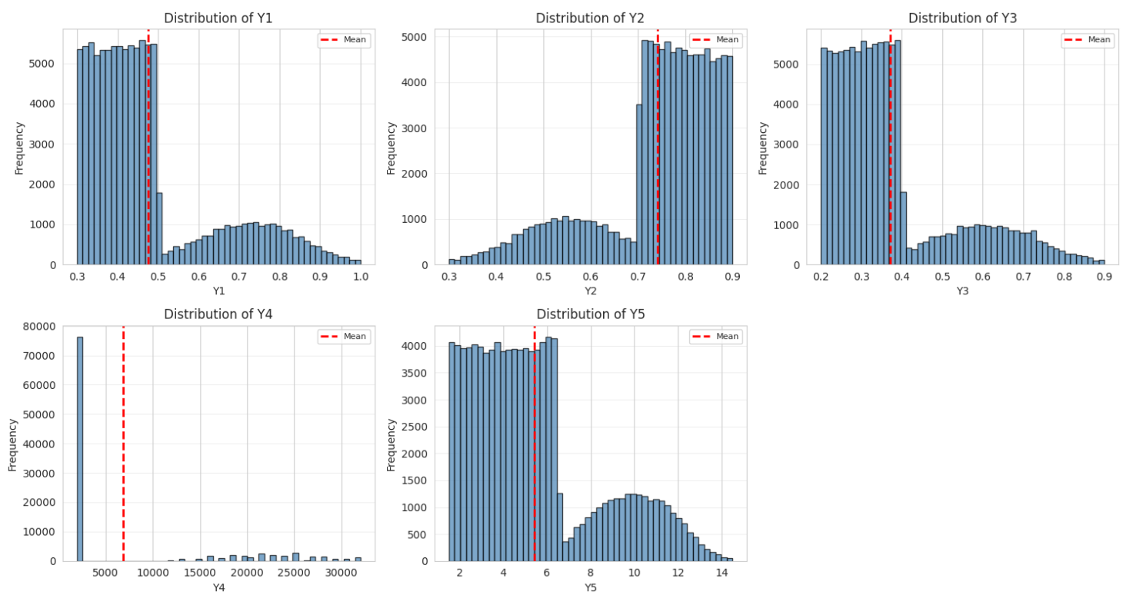
Data exploratory and Preprocessing (2/4)
EDA Insight: Outcomes exhibit strong skewness and bimodality.
Implication: Treatment effects are heterogeneous and non-linear.
Solution:
Log1p transformation for cost and time outcomes.
Causal meta-learners with outcome-specific modeling.
R-loss.

Slide 8
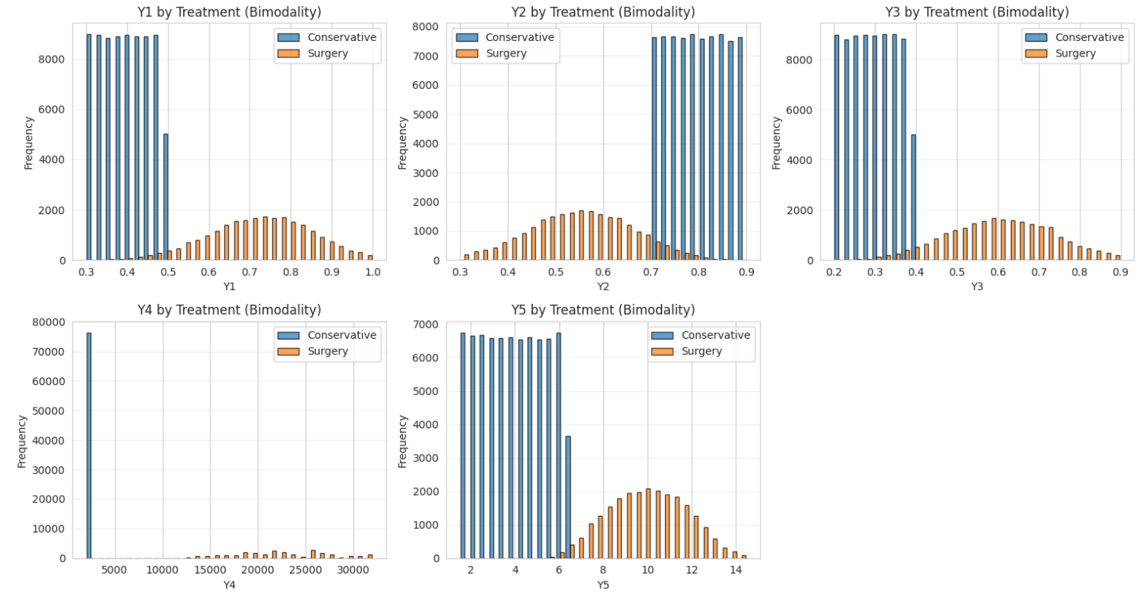
Data exploratory and Preprocessing (3/4)
EDA Insight: Outcome distributions differ substantially by treatment group.
Implication: Differences may reflect causal effects or confounding.
Solution: Doubly robust causal learning with balance diagnostics.

Slide 9
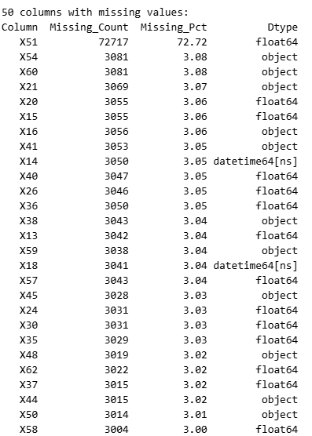
Data exploratory and Preprocessing (4/4)
EDA Insight: No Duplicate, Substantial and variable missingness across baseline features.
Implication: Dropping data would introduce bias and reduce power.
Solution: Structured imputation with explicit missingness indicators.

Slide 10
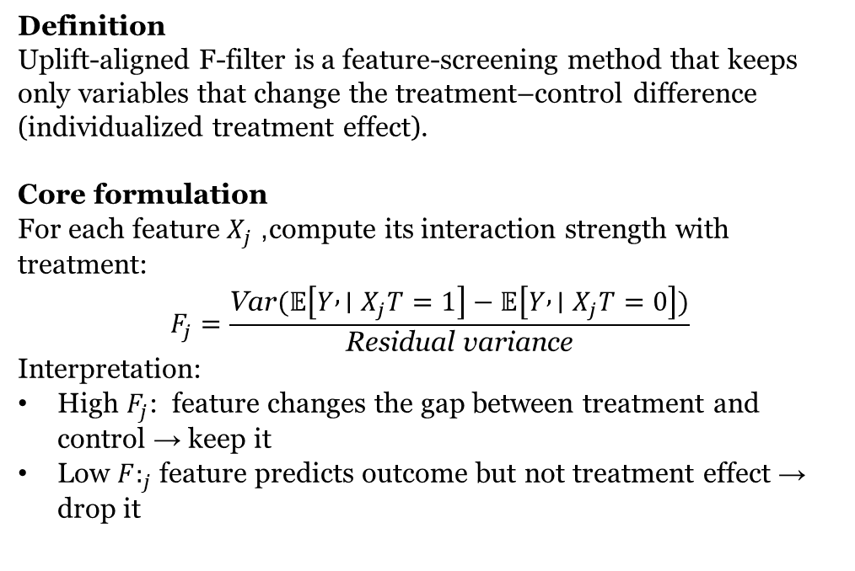
Key Methodology (1/5)
Definition Uplift-aligned F-filter is a feature-screening method that keeps only variables that change the treatment–control difference (individualized treatment effect).
Core formulation For each feature $X_{j}$, compute its interaction strength with treatment:
$$F_{j}=\frac{\text{Var}(𝔼\left[Y , ∣X_{j}T=1\right]−𝔼\left[Y , ∣X_{j}T=0\right])}{\text{Residual} \text{variance}}$$
Interpretation:
High $F_{j}$: feature changes the gap between treatment and control → keep it
Low ${F:}_{j}$ feature predicts outcome but not treatment effect → drop it
Uplift-aligned F-filter
Why: Help model focusing on who benefits more rather than just predicting outcomes.

Slide 11
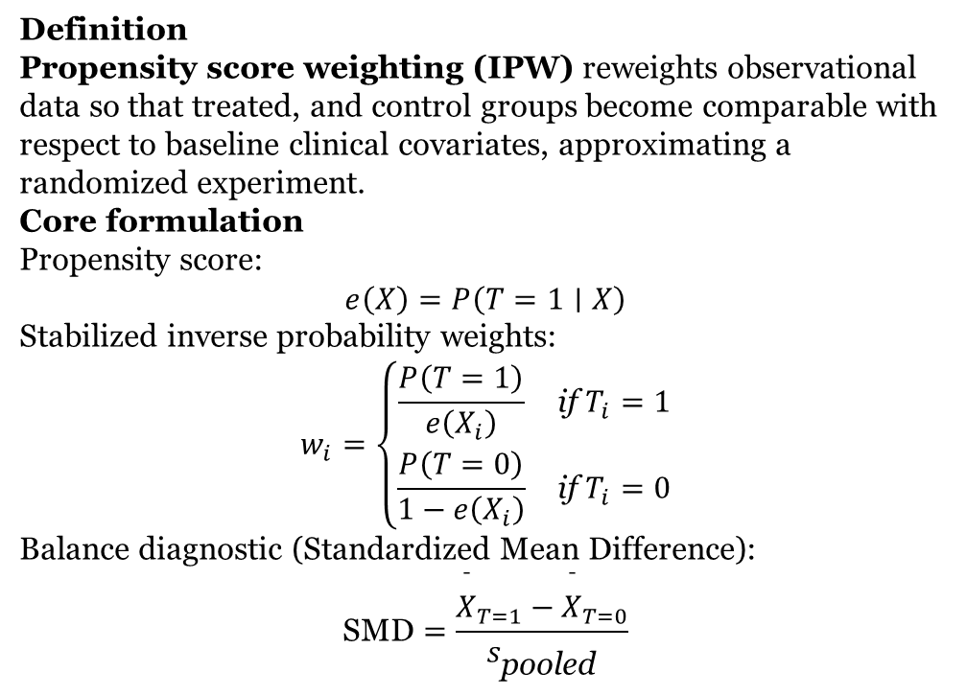
Key Methodology (2/5)
Definition Propensity score weighting (IPW) reweights observational data so that treated, and control groups become comparable with respect to baseline clinical covariates, approximating a randomized experiment. Core formulation Propensity score: $$e\left(X\right)=P\left(T=1∣X\right)$$ Stabilized inverse probability weights: $$w_{i}=\left\{\begin{matrix}\frac{P\left(T=1\right)}{e\left(X_{i}\right)} & \text{if} T_{i}=1 \\ \frac{P\left(T=0\right)}{1−e\left(X_{i}\right)} & \text{if} T_{i}=0\end{matrix}\right.$$ Balance diagnostic (Standardized Mean Difference): $$\text{SMD}=\frac{{\overset{ˉ}{X}}_{T=1}−{\overset{ˉ}{X}}_{T=0}}{s_{\text{pooled}}}$$
Propensity Score Weighting by Logistic Regression Model + Balance Diagnostics
Why: Balance diagnostics justify causal estimation by confirming that treatment groups are comparable.

Slide 12
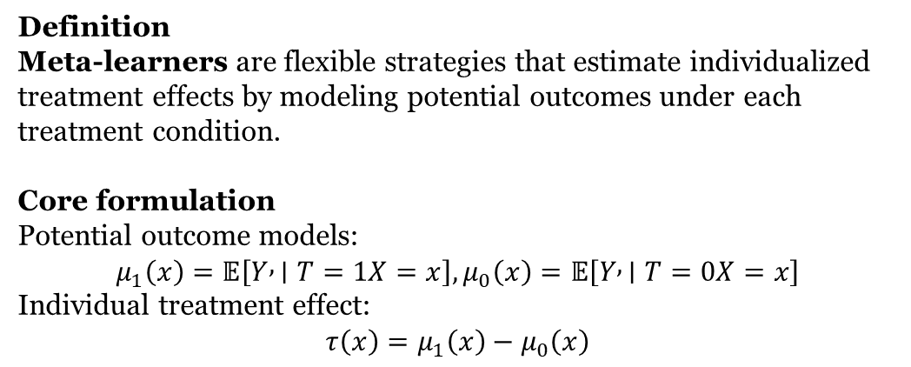
Key Methodology (3/5)
Definition
Meta-learners are flexible strategies that estimate individualized treatment effects by modeling potential outcomes under each treatment condition.
Core formulation
Potential outcome models:
$$μ_{1}\left(x\right)=𝔼\left[Y , ∣T=1X=x\right], μ_{0}\left(x\right)=𝔼\left[Y , ∣T=0X=x\right]$$
Individual treatment effect:
$$τ\left(x\right)=μ_{1}\left(x\right)−μ_{0}\left(x\right)$$
Causal Meta-Learners (S, T, X) with Tree-based models
Why: Meta-learners translate heterogeneous clinical responses into patient-specific causal effects.

Slide 13
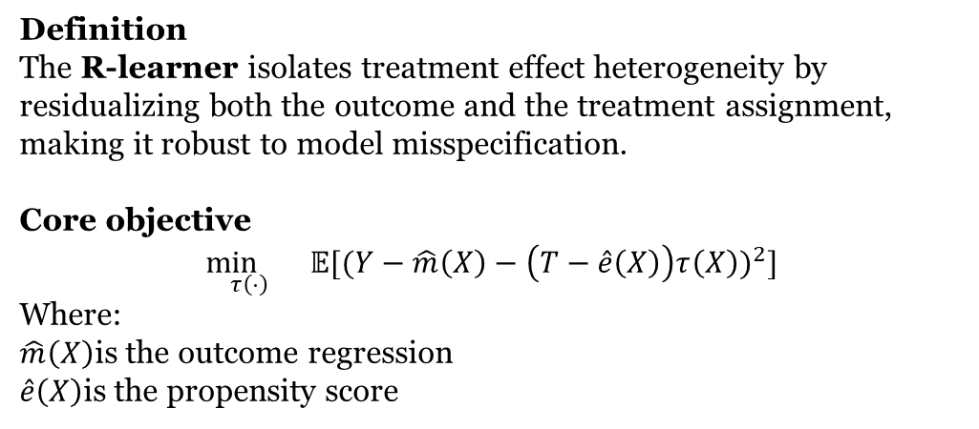
Key Methodology (4/5)
Definition
The R-learner isolates treatment effect heterogeneity by residualizing both the outcome and the treatment assignment, making it robust to model misspecification.
Core objective
$$\underset{τ\left(⋅\right)}{\min{}} 𝔼[(Y−\hat{m}\left(X\right)−\left(T−\hat{e}\left(X\right)\right)τ\left(X\right))^{2}]$$
Where:
$\hat{m}\left(X\right)$is the outcome regression
$\hat{e}\left(X\right)$is the propensity score
Doubly Robust / R-Learner
Why: Doubly robust learning protects causal estimates against residual confounding and model error.

Slide 14
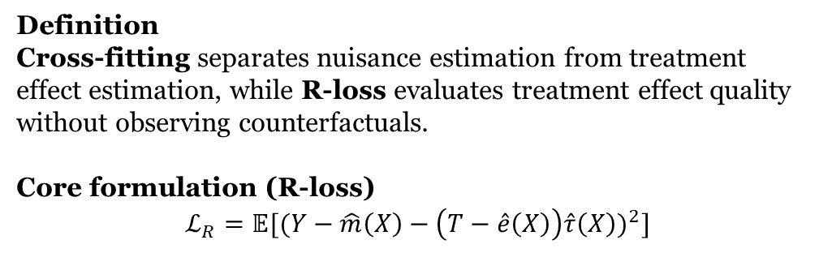
Key Methodology (5/5)
Cross-Fitting + R-Loss Model Selection
Definition
Cross-fitting separates nuisance estimation from treatment effect estimation, while R-loss evaluates treatment effect quality without observing counterfactuals.
Core formulation (R-loss)
$$ℒ_{R}=𝔼[(Y−\hat{m}\left(X\right)−\left(T−\hat{e}\left(X\right)\right)\hat{τ}\left(X\right))^{2}]$$
Why: Cross-fitted R-loss ensures that the selected model best estimates causal effects, not just predictions.

Slide 15
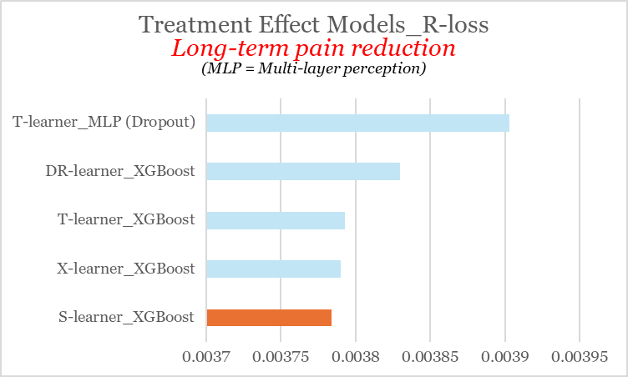
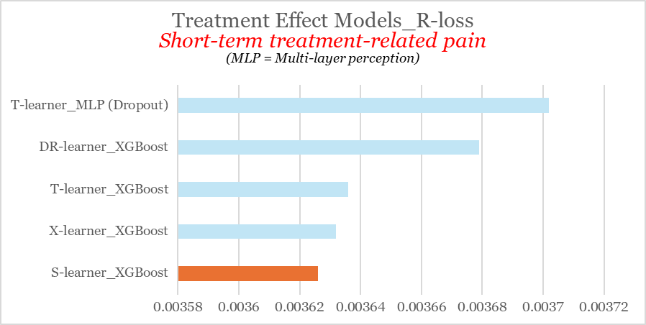
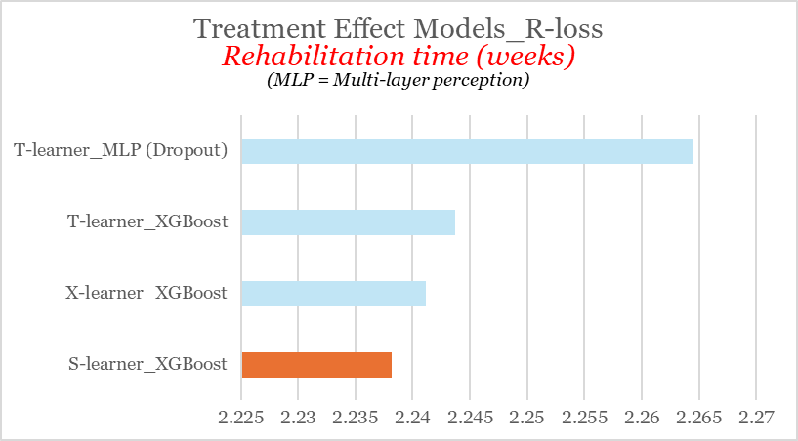
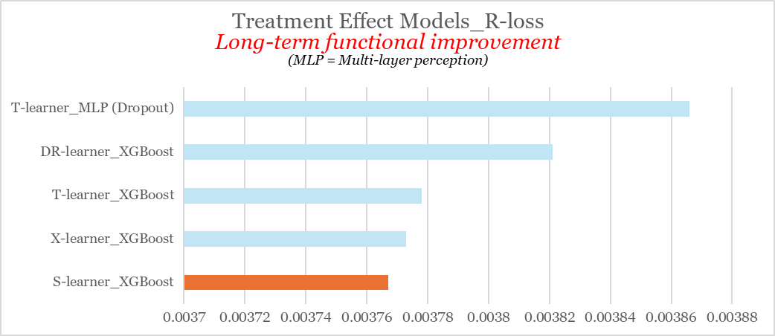
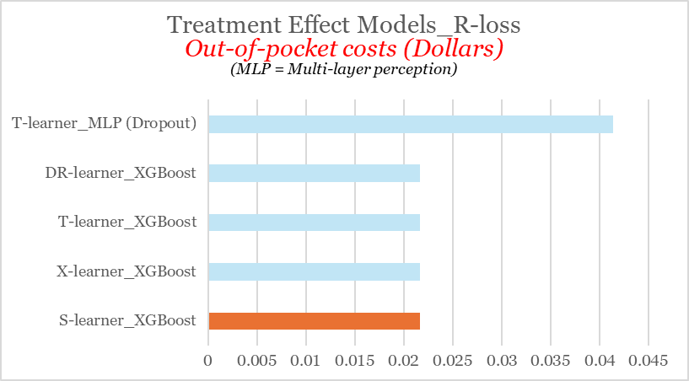
Causal Models (1/2)
S-learner gives the most accurate individualized treatment effects

Slide 16
Causal Models (2/2)
Outcome | Arm | MAE | RMSE
Y1 | T=1 | 0.050 | 0.058
Y1 | T=0 | 0.050 | 0.058
Y2 | T=1 | 0.050 | 0.058
Y2 | T=0 | 0.050 | 0.058
Y3 | T=1 | 0.050 | 0.058
Y3 | T=0 | 0.050 | 0.058
Y4 | T=1 | 25.325 | 29.446
Y4 | T=0 | 25.031 | 28.916
Y5 | T=1 | 1.254 | 1.449
Y5 | T=0 | 1.257 | 1.451
Model accuracy is balanced across treatment arms
Predictions are clinically reasonable
Pain & function: ~0.05
Rehab time: ~1 week
Cost: ~$25

Slide 17
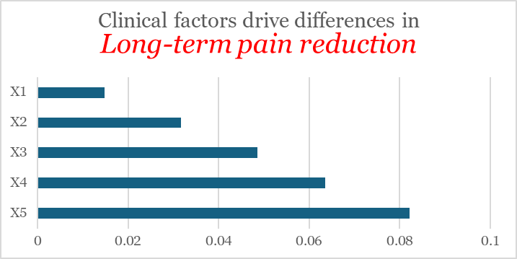
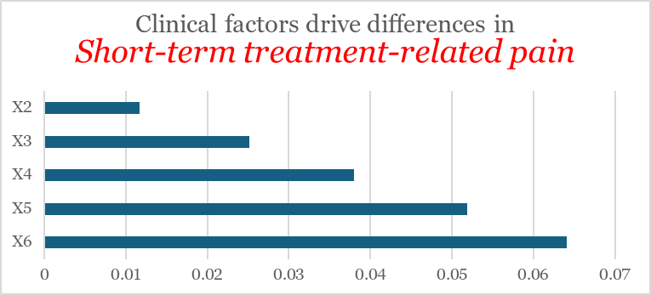
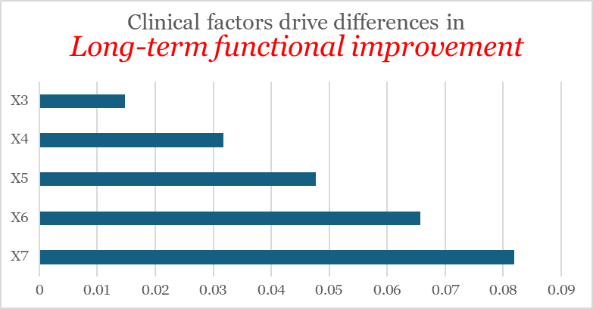
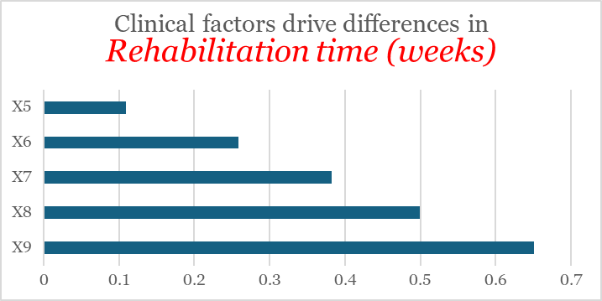
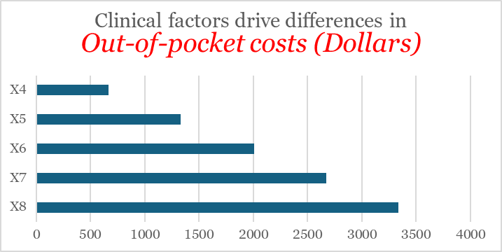
Clinical Heterogeneity
The same surgery leads to very different benefit–cost profiles across patients.
Surgery does not benefit everyone in the same way
Different baseline clinical factors drive pain relief, functional recovery, rehabilitation time, and cost
The need for individualized, preference-aware treatment decisions.
Outcome | TE Range
Pain Reduction | −0.01 to +0.53
Short-term Pain | −0.42 to -0.00
Functional Improvement | −0.01 to +0.53
Cost Impact (USD) | +$10k to +$30k
Rehab Time (weeks) | +3.2 to +8.7

Slide 18
Conclusion
The S-learner with XGBoost Model can be used to compare treatment options and select the one that best fits a patient’s condition and priorities.

Slide 19
Thank you

